Slide 1
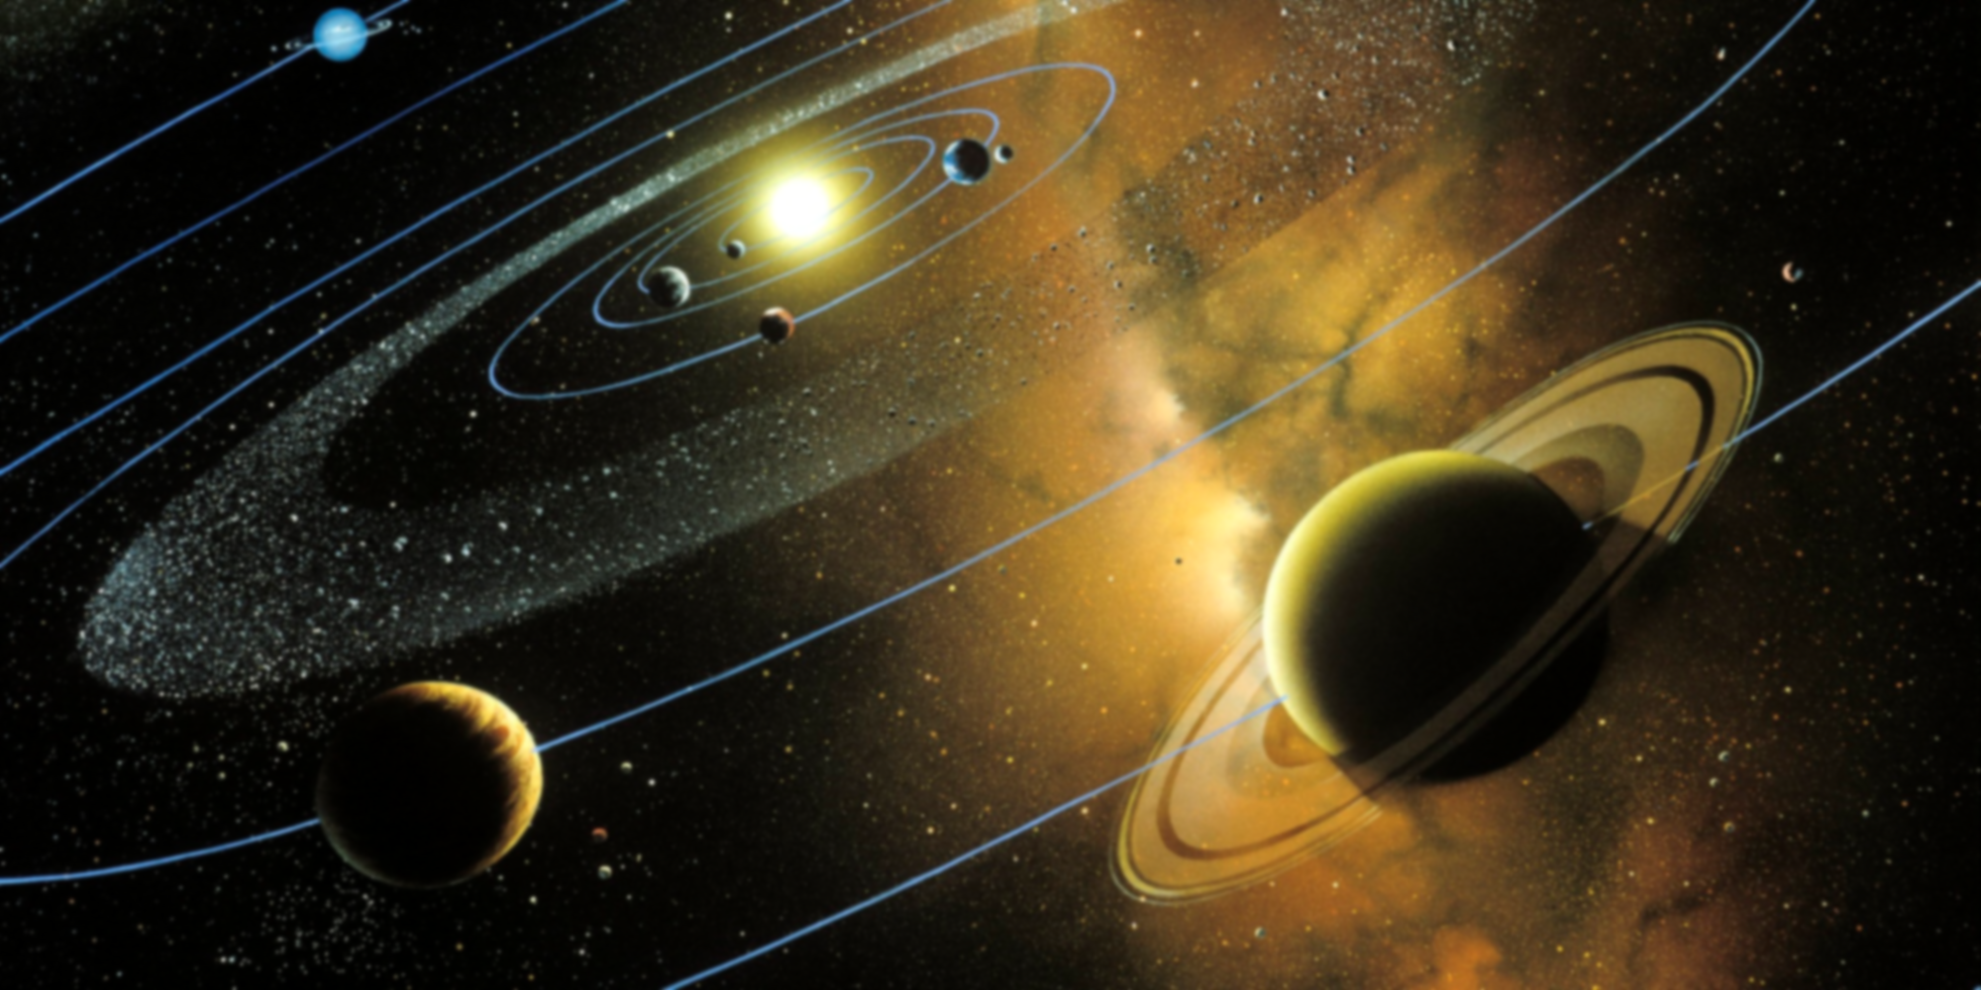
Solar System Simulator.
Brennan Metzelaar & Joshua Nuez

Slide 2
Overview:
creates a model of the solar system:
Proportionally accurate
Animated
Allows user input
Focused on High Cohesion

Slide 3
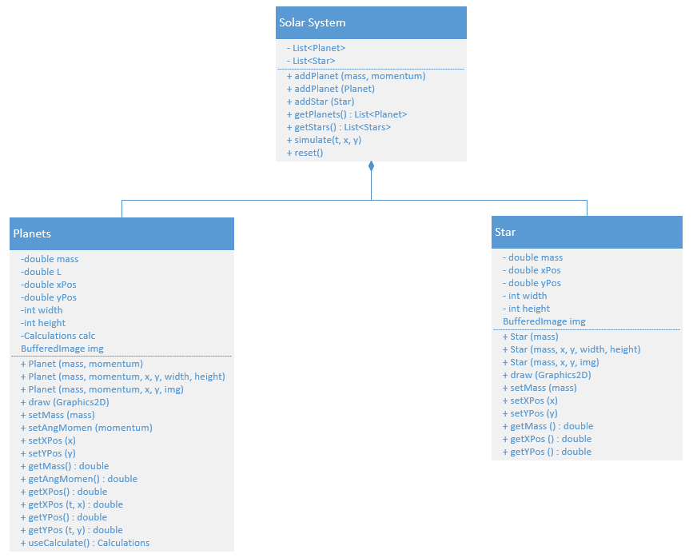
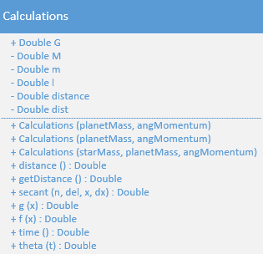
Design/UML:

Slide 4
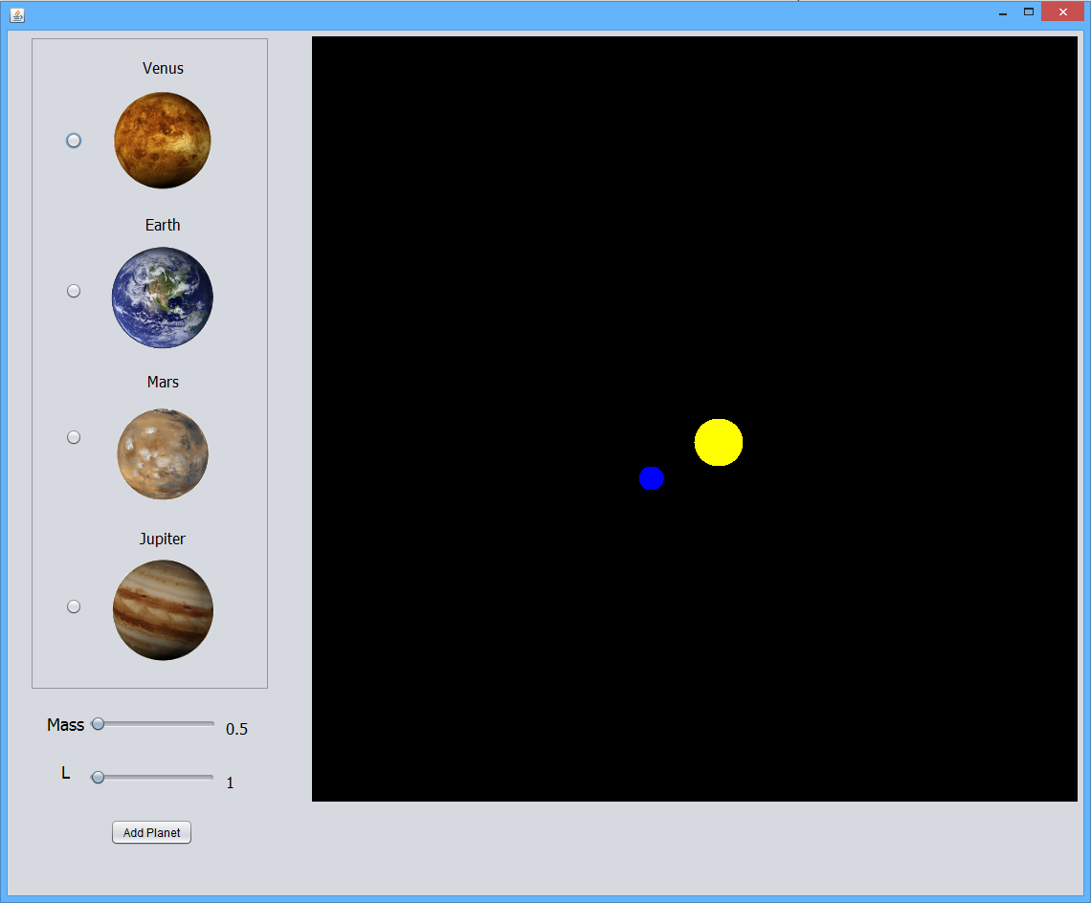
Application Development

Slide 5
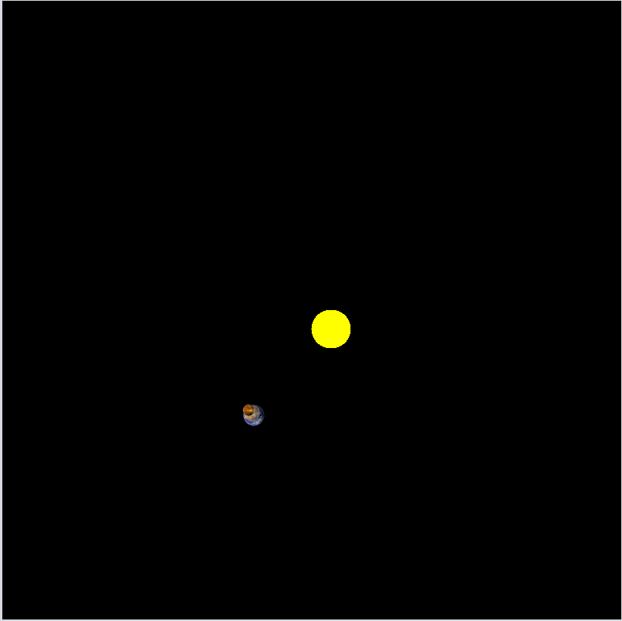
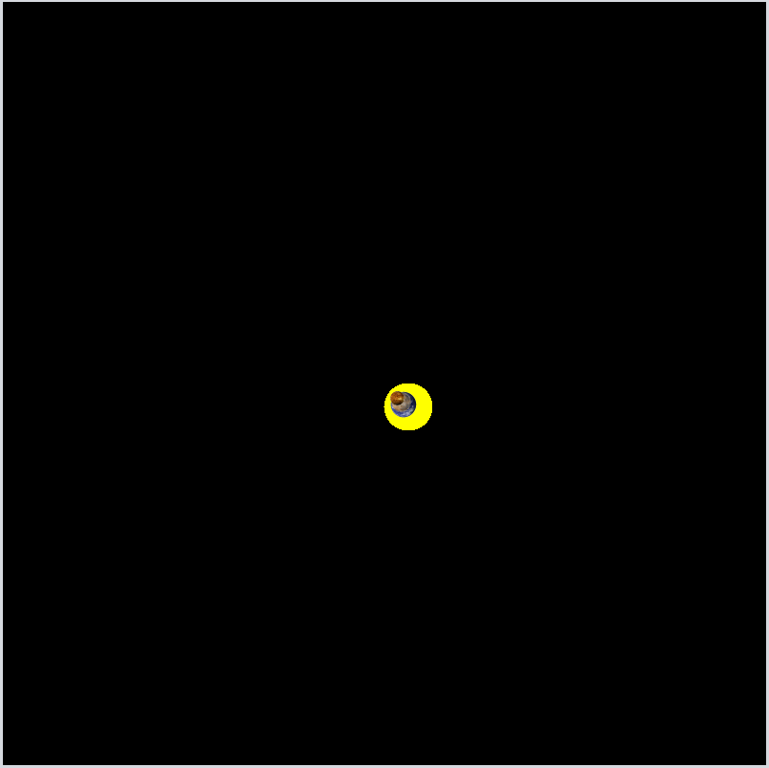

Slide 6


Slide 7
Demo

Slide 8
Challenges (NONE we’re awesome)
Debugging: have no proper understanding of graphics
Planning the scale of the project

Slide 9
Possible Improvements
Multiple suns (application has the capacity to handle multiple suns)
Collision
Zoom, Better UI
Asteroids
Moons
Hover Event
More accurate Calculations
Scaling

